Slide 1


Speedment OMoC Live Data Agent™
Free Your IBM OMoC Production Data to Your Business Users

Slide 2

THE PROBLEM
Data Access on IBM OMoC
IBM OMoC strictly denies direct access to YOUR data via JDBC or via any database replication technology.
The only way IBM provides YOU the ability to extract YOUR data is via an extract agent.

Slide 3

EXISTING SOLUTION
IBM Data Extract Agent
Uses FTP/CSV files that are cumbersome and difficult to work with.
Highly compromises security when data is sitting in flat files.
Creates “heavy” workloads to push the data over FTP. That’s why they restrict to use on the DR instance and on an hourly basis.
Leaves it up to YOU to convert those files into something your reporting tools can use.

Slide 4
NEW SOLUTION
Speedment OMoC Live Data Agent™
Unlocks YOUR data trapped in IBM OMoC database and provide it to YOUR business for analysis, in near real time
Easy configuration using existing IBM API’s to dictate what data is fed to the Live Data Agent.
Can be configured with in-memory capabilities to allow data to be analyzed with ultra-low latency.
Connects to enterprise reporting tools and makes it possible to tailor-make live reports.
Supports IBM’s DataExtracts’ First Run to allow historical data from any number of days up to the current data/time to be synched.

Slide 5


Slide 6
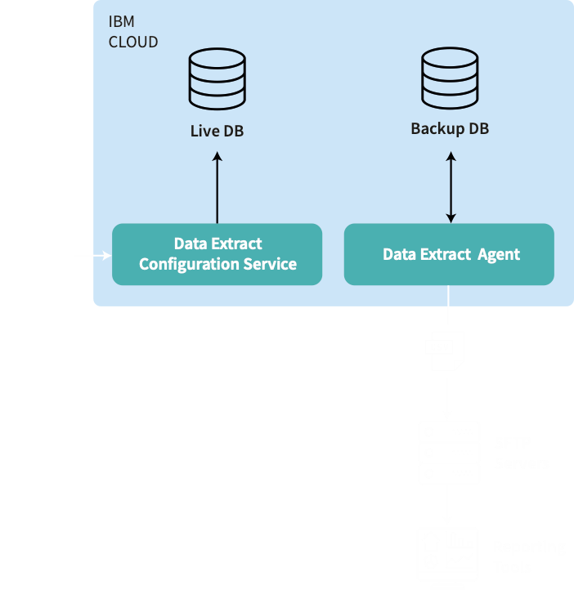
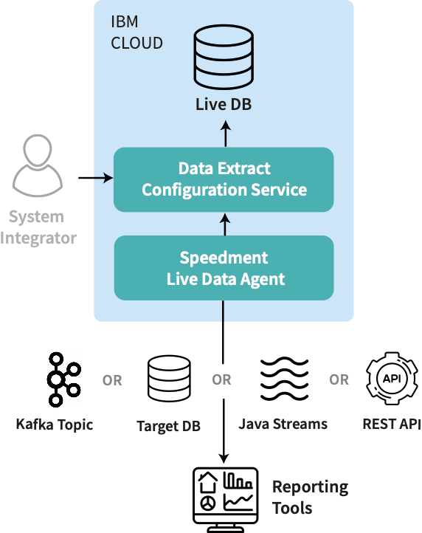
EXISTING SOLUTION
IBM Data Extract Agent
NEW SOLUTION
Speedment OMoC Live Data Agent™

Slide 7

EASY DEPLOYMENT
Being tailor-made for IBM OMoC, Live Data Agent™ leverages standard IBM extension frameworks and existing API’s to configure and execute the extracts.

Slide 8

DATA EXPOSURE
YOU are free to choose
Kafka Topic Reliable stream of data updates that can be consumed by your business logic.
Target DB Shadow database that can be used by large number of standard tools, e.g. Tableau, Cognos, etc.
Java Streams Write your own applications and leverage Speedment Hyperstream™, revolutionary in-memory technology to make analyzing your data exceedingly fast.
REST API Instantly connect web applications via REST, leveraging Speedment Hyperstream™

Slide 9
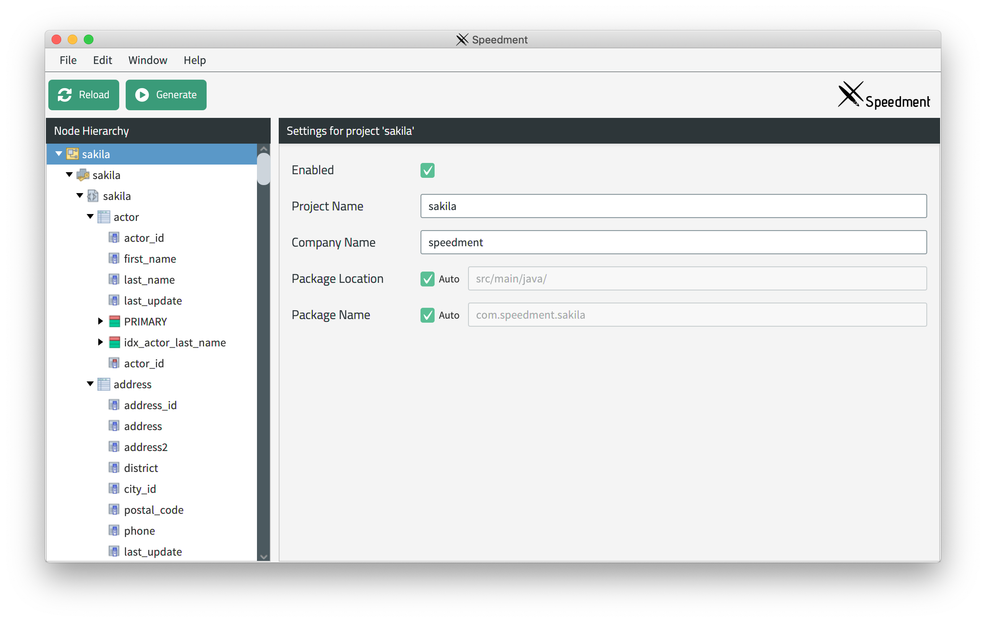
BUILT-IN TOOLS
Rapid Java development
Queries Expressed as Standard Java Streams Speedment leverages the standard Java Stream API to enable database querying using lambdas without a single line of SQL. A custom delegator is used to optimize the resulting SQL queries for reduced database load, latency, and network load.
Powerful Code Generator Analyses the underlying data sources’ metadata and automatically creates Java code which directly reflects the structure of the underlying data sources. The graphical interface allows many custom configurations and optimizations.
long noLongFilms = films.stream()
.filter(Film.LENGTH.greaterThan(120))
.count();

Slide 10




BUILT-IN TOOLS
Hypersonic Performance
Revolutionary Memory Manager Leveraging Speedment HyperStream™ to perform data analytics exceedingly fast.
In-JVM-Memory Operates on an in-JVM-memory copy of the shadow DB which avoids any load on the local DB when invoking the Speedment Streams’ API’s.
Commercial Deployments Where security, availability, and performance cannot be compromised.

Slide 11
OPTION
Library with graphical components
Graphical Components If you add a tool for building web applications in Java with prebuilt graphical components, it is fast and easy to tailor-make your reports. In this example we have used the Vaadin platform.

Slide 12




SUMMARY OF ADVANTAGES
Near-real time access to a selected stream of any instance of IBM OMoC (DEV/QA/PRE-PROD/PROD/DR) database tables with minimal latency measured in minutes vs. hours.
Highly secure and efficient platform for extracting OM data. Doesn’t leave the data at rest in CSV file systems that can be readily compromised.
Extract the data you want at the frequency you need at the rate your system can handle. Your OMoC..won’t feel a thing!
Stream your data directly into a shadow database or into a format that is naturally consumable (e.g. JDBC or Java Streams) by your preferred reporting tools (e.g. Tableau, Cognos, etc.)
Leverages all the frameworks of the IBM OMoC solution (e.g. existing data extract configuration API’s and Agent Server architecture) with no custom tables or complex extensions.
Can be set up and running in days not weeks.
Deployed like any other customer extension in your OMoC environment.
Allows replication of your data to multiple consumers, and not just one.

Slide 13
Thanks!
info@speedment.com
https://speedment.com/live-data-agent/

Slide 14
INVENTORY REPORT - List of inventory items

Slide 15
INVENTORY REPORT - Detailed inventory item

Slide 16
INVENTORY REPORT - Detailed inventory item

